Slide 1




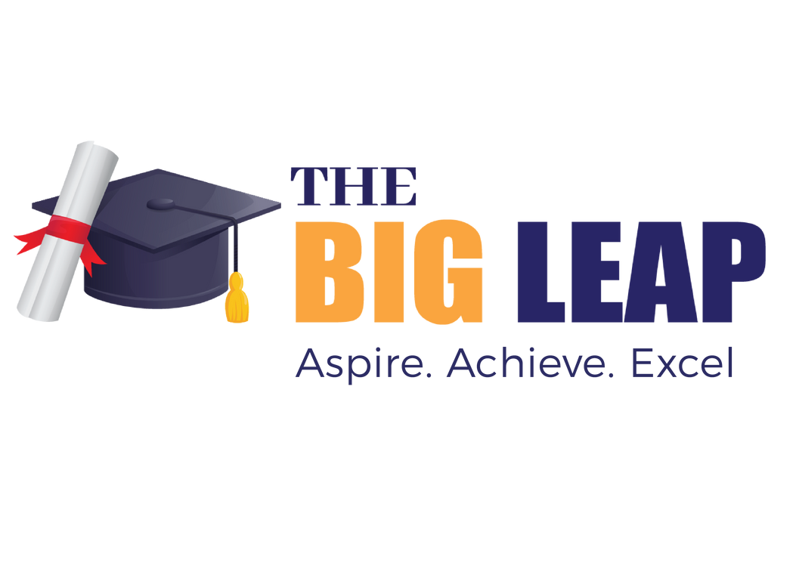




Idea submission

Slide 2


Team details
TeamLead:Name: Aditya Aaryan
Contact: 8976093639
Email:adityaaaryan.cs24@bmsce.ac.in
Team Member 2: Name:Aarushi Chaturvedi
Contact: 7448156075
Email:aarushi.cs24@bmsce.ac.in
Team Member 3: Name: Navya Agrawal
Contact: 7389441606
Email: navyaagrawal.cs24@bmsce.ac.in

Slide 3


Our solution
Our AI-powered platform helps farmers optimize yield and profitability through crop recommendations, soil health monitoring, pest and disease detection, automated irrigation, and AI-driven market analysis. By leveraging real-time data and AI insights, it enables smarter, more sustainable farming decisions.

Slide 4

TECHNICAL APPROACH
Our AI-powered platform empowers farmers with data-driven insights to enhance productivity and profitability.
Our Key features include:
AI Powered Crop Recommendations:
Suggests optimal crops based on soil composition, weather, and sensor data.

Slide 5
TECHNICAL APPROACH
Soil Health Monitoring:
Analyzes soil test data and images for issue detection and solutions.
Pest & Disease Detection:
Identifies crop diseases and pests through image analysis with treatment suggestions.
Automated Irrigation:
Recommends efficient watering schedules using weather and soil moisture data.
Market Trends & Pricing:
Predicts crop prices using AI-driven market analysis to maximize profits.

Slide 6
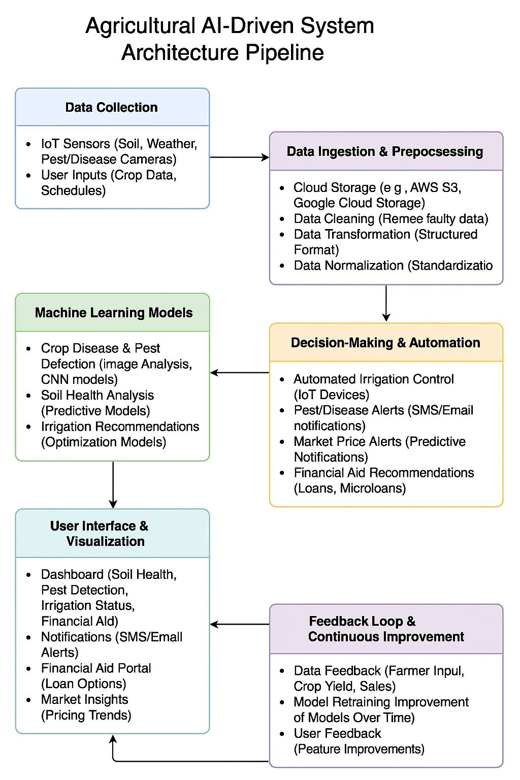
Workflow/pipeline

Slide 7
Feasibility & FUTURE SCOPE
Pros
Comprehensive Solution: Integrates soil health monitoring, pest and disease detection, automated irrigation, and financial aid, providing a one-stop platform for farmers.
Financial Empowerment: Offers microloans and credit scoring based on real-time crop and financial data, helping farmers access capital and improve their financial stability.
AI and IoT Integration: Leverages AI and IoT for real-time data analysis and automation, increasing productivity, precision, and efficiency in farming practices.
Global Scalability: The platform can be customized for different crops, regions, and climates, enabling global reach and adaptation to diverse agricultural needs.
Sustainability Focus: Promotes eco-friendly farming practices through efficient irrigation, soil health monitoring, and waste reduction, contributing to long-term environmental sustainability.

Slide 8
Feasibility & FUTURE SCOPE
Cons
High Initial Costs: Significant investment required for technology setup, infrastructure, and farmer training, which may be a barrier for smaller farms.
Data Reliability: The effectiveness of the platform depends on the accuracy of data from sensors and AI, which may be impacted by technical issues or environmental factors.
Technology Adoption Barriers: Farmers, especially in rural or underserved areas, may struggle with adopting new technologies due to limited access to devices or internet connectivity.

Slide 9
Feasibility & FUTURE SCOPE
Our Future Scopes
1. Comprehensive Agricultural Solutions
Features: Soil health monitoring, pest & disease detection, automated
irrigation, and market trends/predictive pricing.
Benefit: Empowers farmers with real-time data and actionable insights
for better crop production and financial stability.
2. Scalable to Global Markets
Localized Data Models: Tailored for different crops, regions, and climates.
Global Expansion: Easily adaptable to diverse agricultural needs and
markets worldwide.

Slide 10
Feasibility & FUTURE SCOPE
3. Financial Aid and Microloans
AI-driven Financial Support: Personalized credit scoring and financial aid based on crop
health and predicted yields.
Global Impact: Provides access to loans and financial services to farmers, helping
break the debt cycle.
4. Integration with Emerging Technologies
AI & IoT: Continual system improvement through machine learning, sensor integration,
and real-time analytics.
Automation: Future integration of full farm management tools and automated practices.
5. Future Growth and Sustainability
Global Food Security: Enhances crop yields, reducing hunger and food insecurity.
Environmental Impact: Promotes sustainable farming with carbon footprint tracking
and climate resilience.

